Slide 1
My Smartphone Knows What You Print: Exploring Smartphone-based Side-channel Attacks Against 3D Printers
CCS, Vienna, Austria, October 2016
Chen Song, Feng Lin, Zhongjie Ba, Kui Ren, Chi Zhou, Wenyao Xu

Slide 2

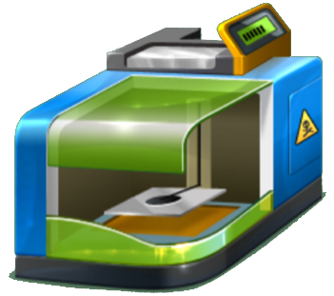
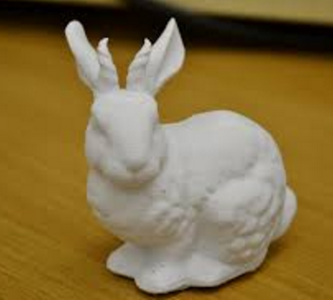
3D Printing
Cyber Design
3D Printing
Physical Object

Slide 3
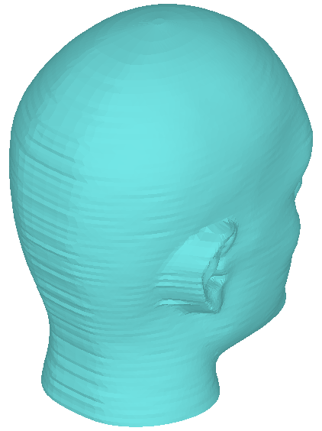



3D Printing Principle
Add layers of material one at a time to build the solid part from bottom to top
Design
3D Printing => Structure-free
Slicing
3D Printing

Slide 4
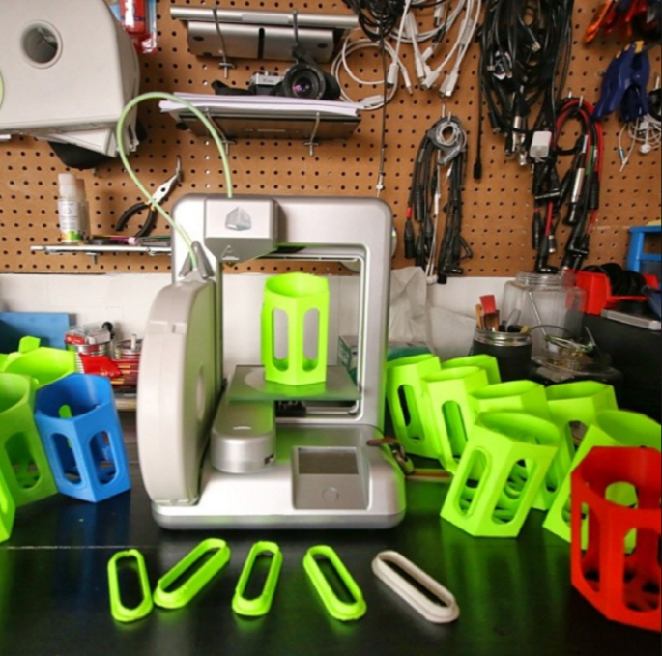
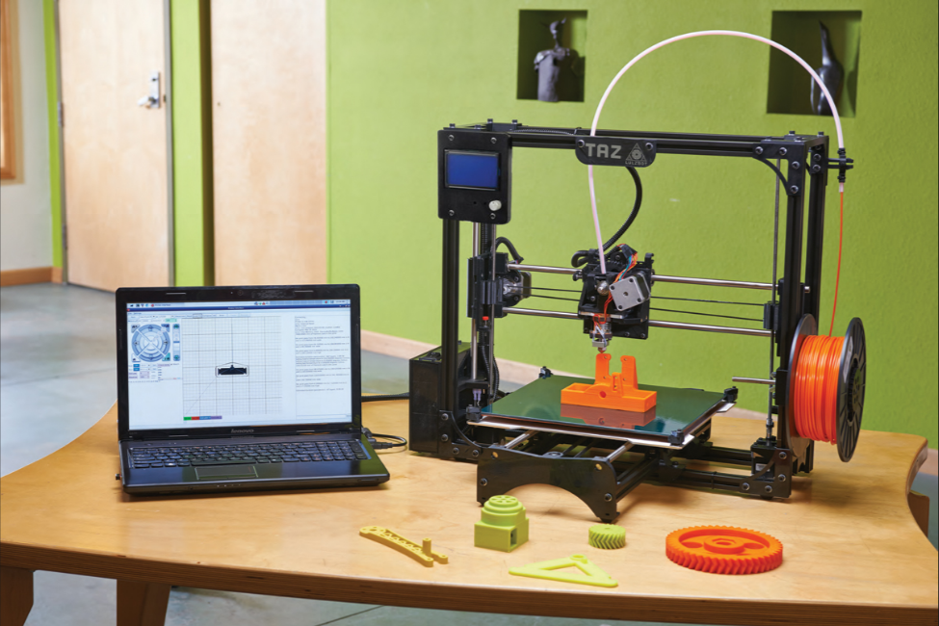
3D Printer
Notes:
Widely accessible and affordable, can use anywhere

Slide 5
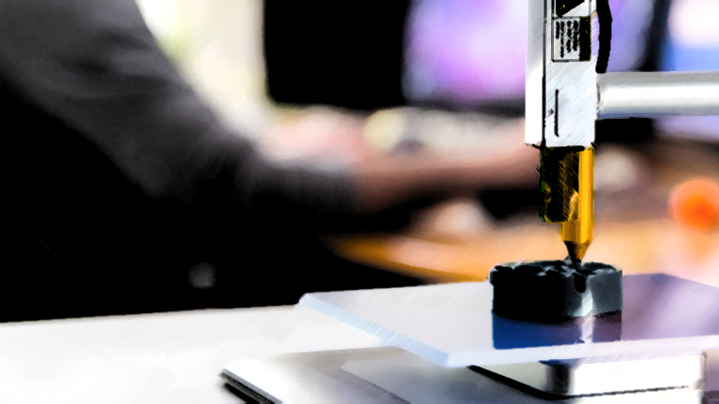

3D Printing Market
$21 Billion by 2020

Slide 6
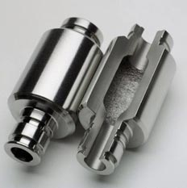
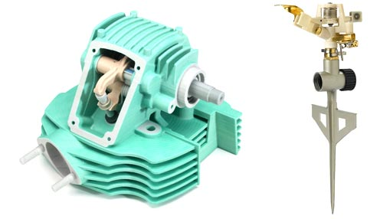
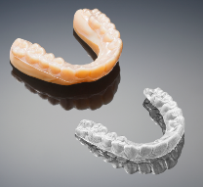
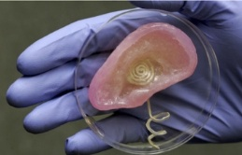
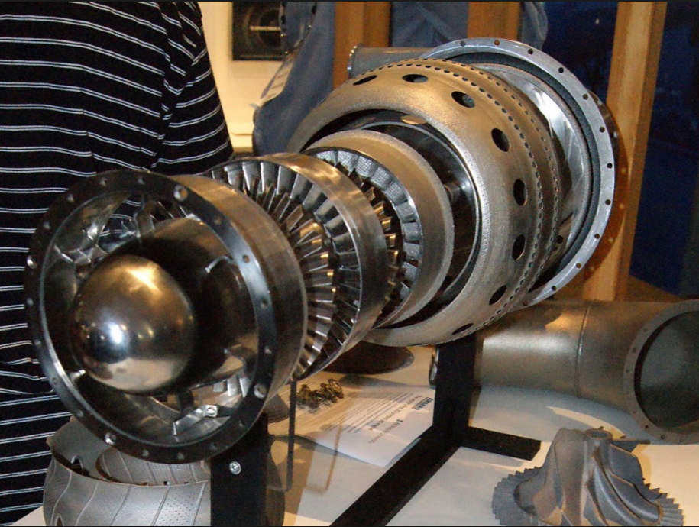
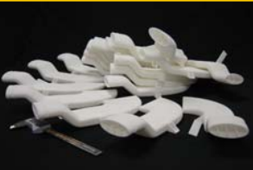

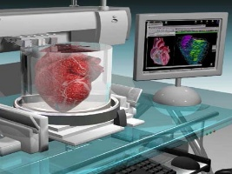
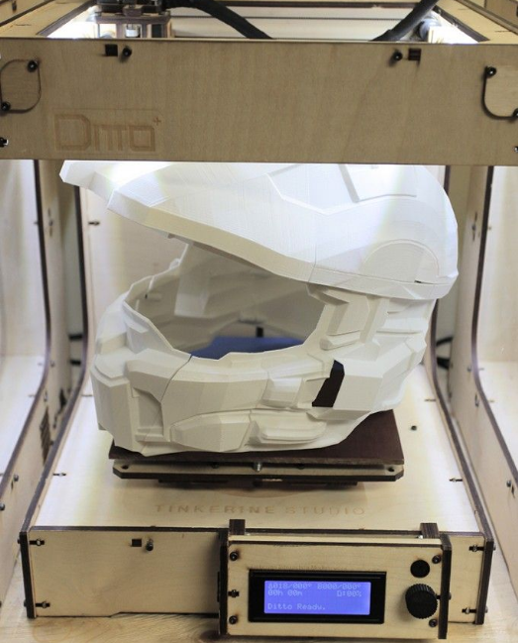
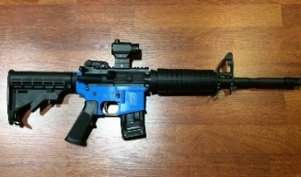
3D Printing Application
3D Printing
Industrial Product
Health-care Tool
Aerospace Unit
Biomedical
Organ
Military Device
Notes:
On the right, high tolerance engine parts were printed using a process called “Electron Beam Melting” and finished with traditional machining processes. While not the norm these uses begin to suggest what is possible in medicine and industry.

Slide 7



3D Printing Application
3D Printing
Industrial Product
Health-care Tool
Aerospace Unit
Biomedical
Organ
Military Device
Notes:
On the right, high tolerance engine parts were printed using a process called “Electron Beam Melting” and finished with traditional machining processes. While not the norm these uses begin to suggest what is possible in medicine and industry.

Slide 8


Is 3D printing system safe from attack?

Slide 9
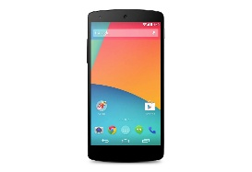
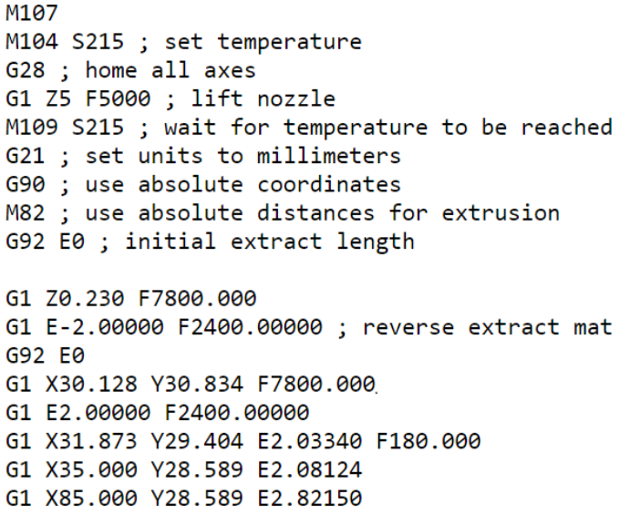
Unobtrusive Side-channel Attack
Distance Physical Attack
IP Design: G-code File

Slide 10
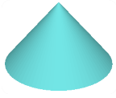

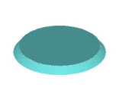
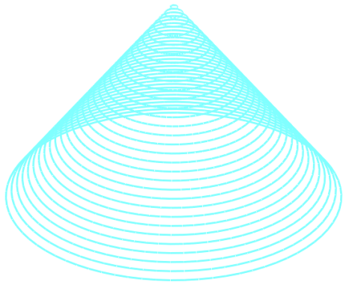


Side-channel Attack Principle
G-code File
Printing Trajectory
Reconstructed G-code File
Predicted Printing Trajectory

Slide 11



Our proposed 3D Printer IP Attack
Side-channel Detection
Printing Status Prediction
IP Reconstruction

Slide 12


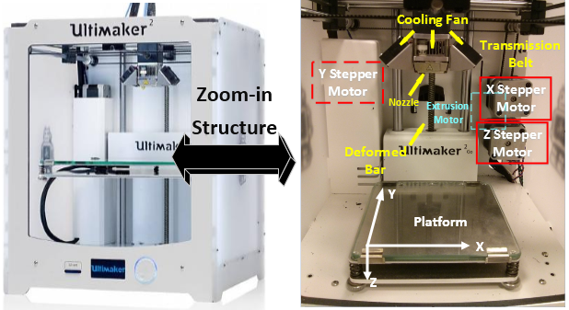
Side Channel Emission
3D Printer Physical Structure
Emitted Side Channels

Slide 13
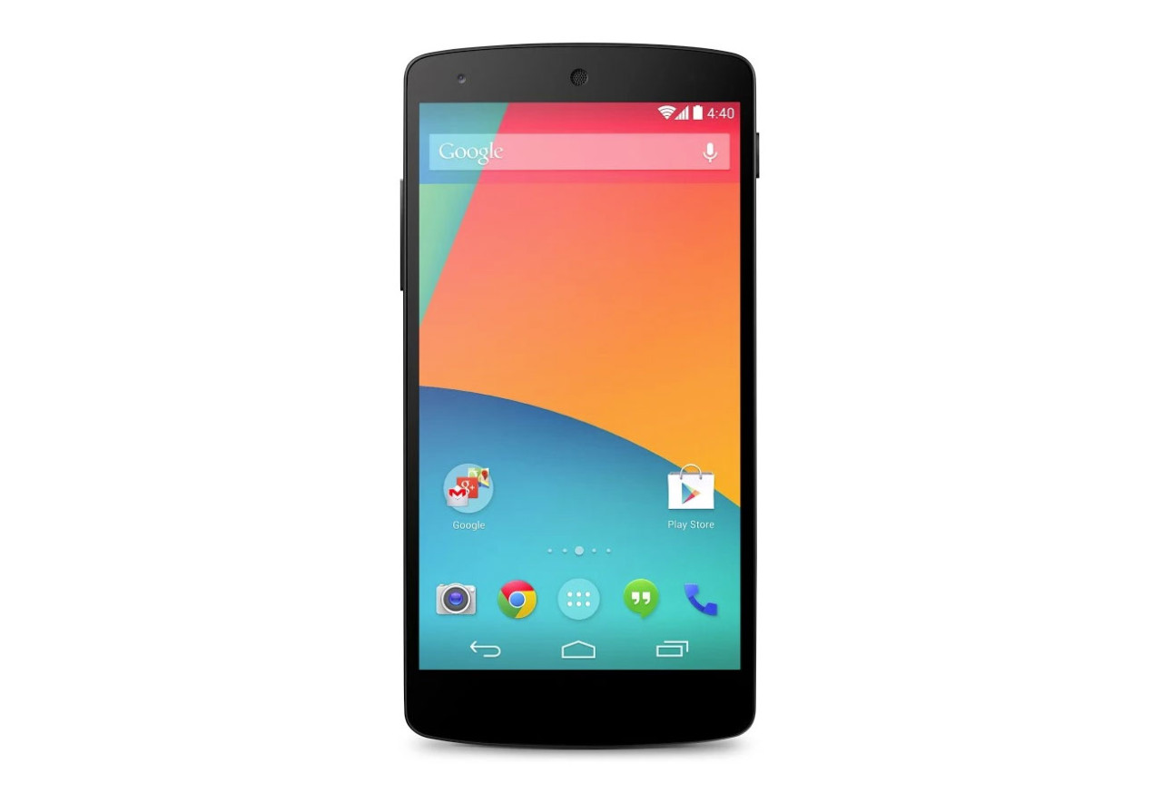
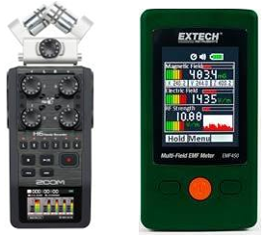

Side Channel Detection
Professional Devices
Magnetometer
Smartphone-based Attack
Most pervasive daily device
Rich on-board sensors
Inconspicuous attack
Zero launching barrier
Microphone
Notes:
Prof devices are fairly expensive, hard-to-deploy, and most importantly, too eye-catching (not practical in real attack).

Slide 14
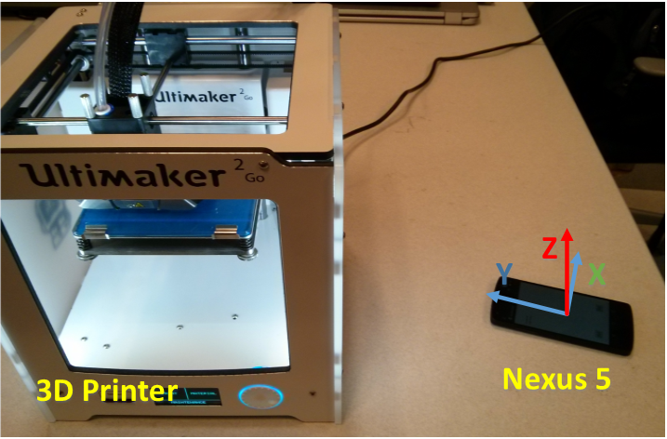
Side Channel Detection

Slide 15
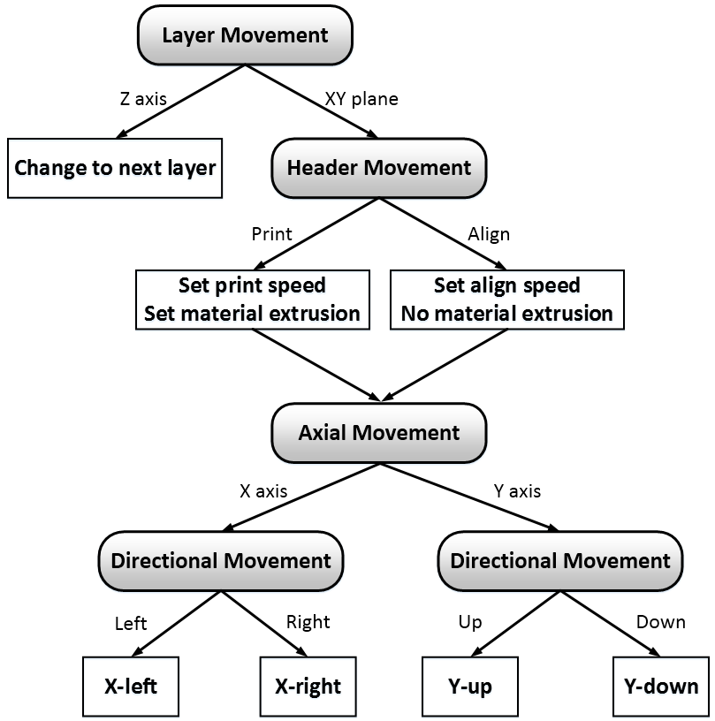
Primitive Operation
Category
Relationship
Layer Movement
Primitive Operation
Header Movement
Axial Movement
Directional Movement

Slide 16
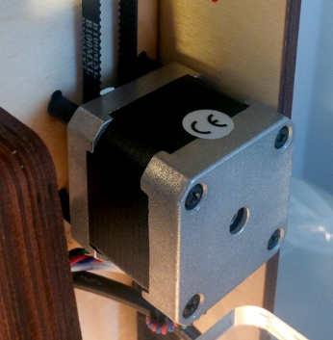
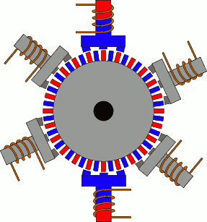
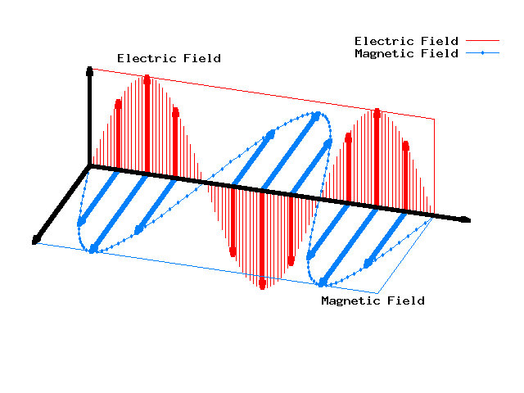
Primitive Operation
Directional Movement Prediction
Stepper Motor
Working Principle
Magnetic Side Channel
Reverse rotation
Reverse side channel
Notes:
The structure of the stepper motor: toothed electromagnets and geared-shape rotor.

Slide 17
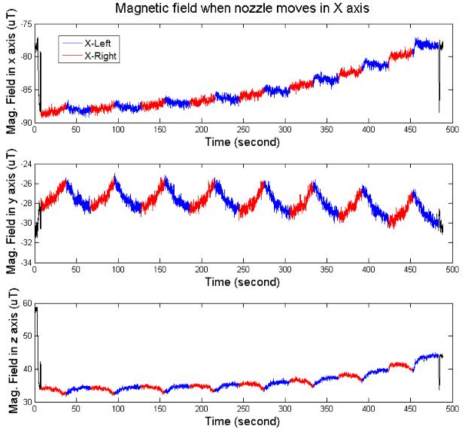
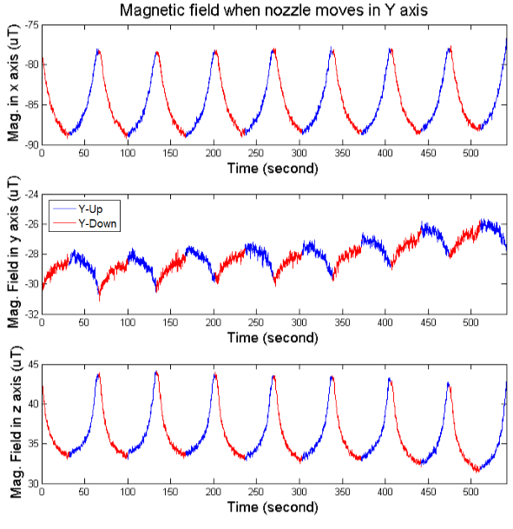
Primitive Operation
Directional Movement Prediction
Detected magnetic side channel in two opposite directions

Slide 18
Primitive Operation
Category
Relationship
Layer Movement
Primitive Operation
Header Movement
Axial Movement
Directional Movement

Slide 19

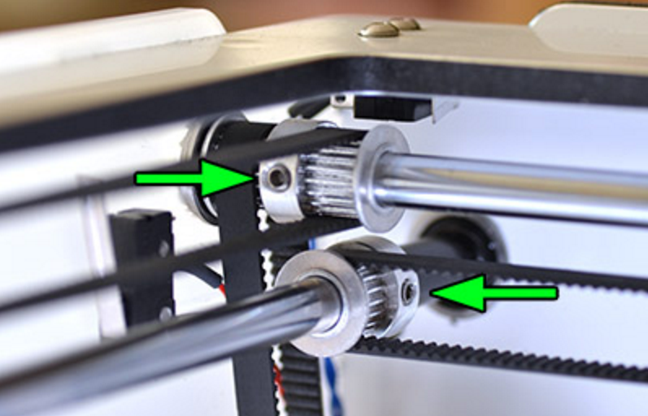
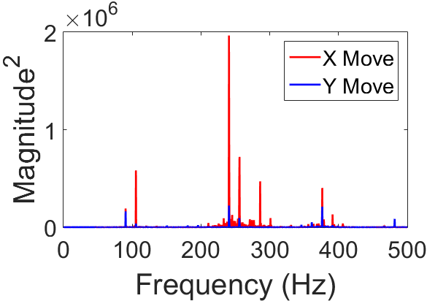
Primitive Operation
Axial Movement Prediction
Separate belt-pulley system
Different acoustic side channel
X Pulley System
X Axial Movement
Y Axial Movement
Y Pulley System

Slide 20
Primitive Operation
Category
Relationship
Layer Movement
Primitive Operation
Header Movement
Axial Movement
Directional Movement

Slide 21
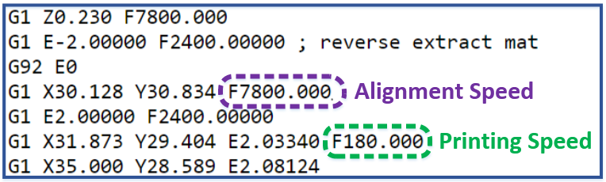
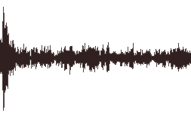
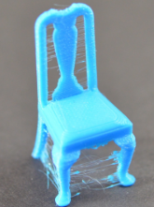
Primitive Operation
Header Movement Prediction
Extremely high align speed to save time and avoid stringing
Much higher amplitude in acoustic side channel
Fast align
Stringing

Slide 22
Primitive Operation
Category
Relationship
Layer Movement
Primitive Operation
Header Movement
Axial Movement
Directional Movement

Slide 23

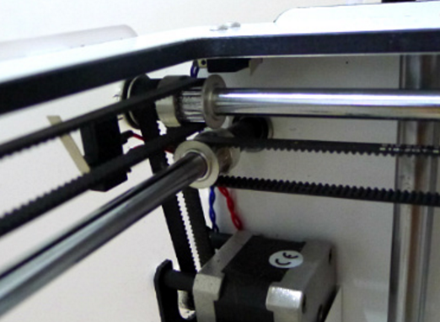
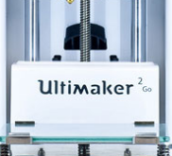
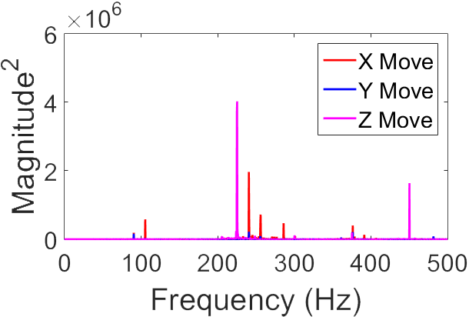
Primitive Operation
Layer Movement Prediction
Different Transmission System for different accuracy control, frequency and work load
Different acoustic side channel
Z movement
Y movement
X movement
X/Y belt-pulley
Z Lead-screw

Slide 24
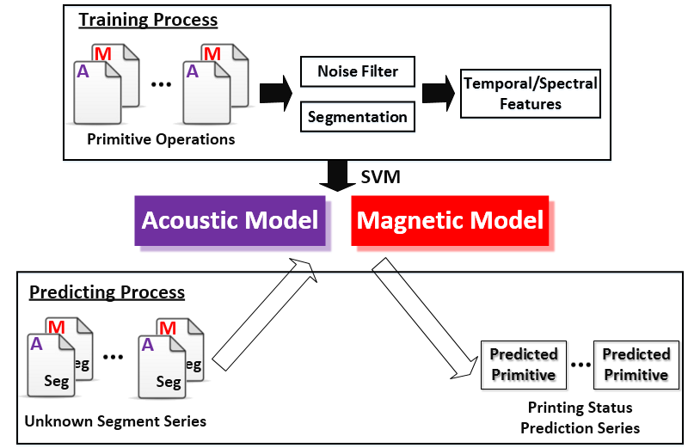
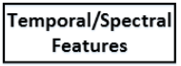
Printing Status Prediction
Frame size
Notes:
Click on ‘Temporal/Spectral Features’ and jump to feature list.

Slide 25
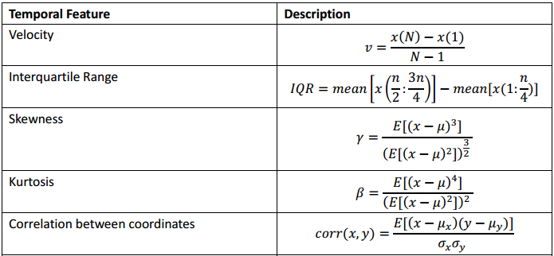
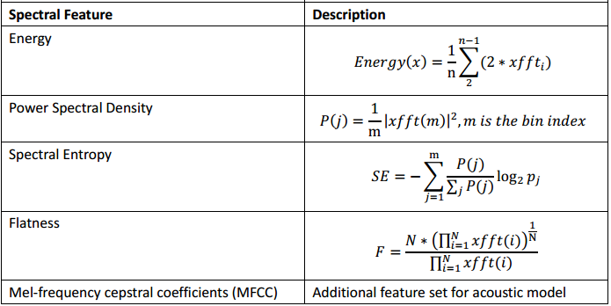
Printing Status Prediction
Notes:
Click on ‘Printing Status Prediction’ to jump back.

Slide 26

G-code Reconstruction
Predicted Primitive
Predicted Primitive
G-code Protocol
Predicted Primitive
(Algorithm 1)
Printing Status Set
Reconstructed G-code
Notes:
Click on ‘Algorithm 1’ and jump to the proposed algorithm.

Slide 27
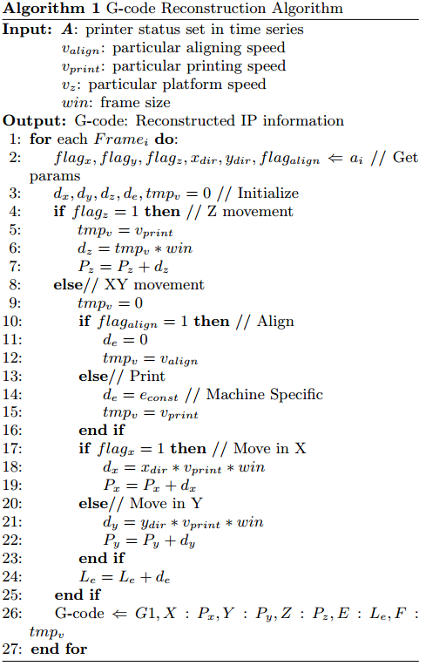
G-code Reconstruction
Notes:
Click on ‘G-code Reconstruction’ to jump back.

Slide 28
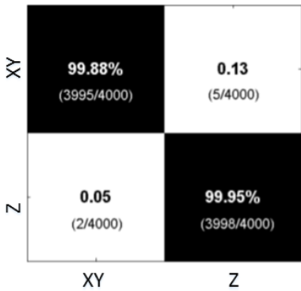
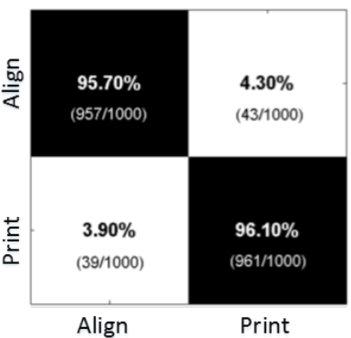
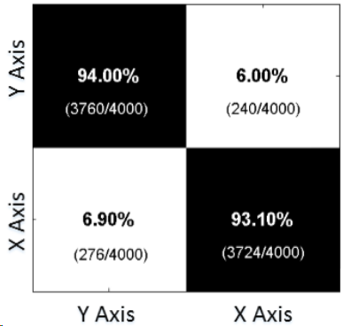
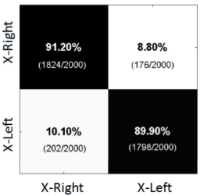
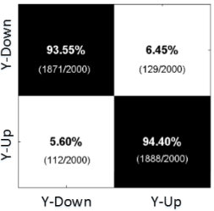
Evaluation (1/5)
Primitive Operation Model Accuracy
Layer Movement Model
Head Movement Model
Axial Movement Model
Average accuracy=94.77%
X Directional Movement Model
Y Directional Movement Model

Slide 29
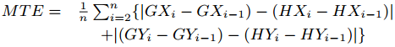
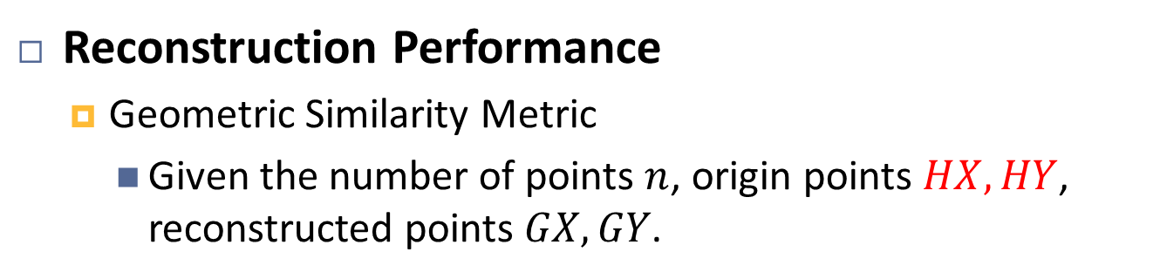
Evaluation (2/5)
Reconstruction Performance
Geometric Similarity Metric
Given the number of points $n$, origin points $HX, HY$, reconstructed points $GX, GY$.
Mean Tendency Error (MTE)
Calculate relative similarity instead of absolute one.
Euclidean Dist. > 0
MTE = 0
Certain offset

Slide 30


Evaluation (3/5)
Reconstruction Performance
Regular shape reconstruction
4-layer shape:
MTE = 5.87%

Slide 31


Evaluation (4/5)
Reconstruction Performance
Complex shape reconstruction
10-layer shape:
Average 10 layers
Most bias appear in X Dir.
MTE = 9.67%
Notes:
Click on ‘Most bias are in X Dir.’ and jump to the explanation.

Slide 32

Evaluation (5/5)
Reconstruction Performance
Complex shape reconstruction
10-layer shape:
Original design
Reconstructed shape

Slide 33
Questions
How does the frame size affect the model accuracy?
Does the smartphone distance affect the attack performance?
Is the smartphone orientation required to be fixed?

Slide 34

Model Accuracy and Frame Size
Larger frame size improves the model accuracy

Slide 35
Questions
How does the frame size affect the model accuracy?
Does the smartphone distance affect the attack performance?
Is the smartphone orientation required to be fixed?

Slide 36



Reconstruction Performance with Attack Distance
Magnetic signal diminishes fast $∝\frac{1}{{Dist.}^{3}}$
Notes:
Maybe a graph containing printer and smartphone in three distances.

Slide 37
Questions
How does the frame size affect the model accuracy?
Does the smartphone distance affect the attack performance?
Is the smartphone orientation required to be fixed?

Slide 38





Smartphone Orientation
Orientation Free Solution
Normalized quaternion $q$ (Android API)
Rotation Matrix $R$:
Calibration: $magData^{′}=R∗magData$

Slide 39



Smartphone Orientation
Small average variation
Carry-on Attack

Slide 40

IP-sensitive, privacy designs are not safe on 3D printer

Slide 41

How can we defend side-channel attack?

Slide 42
Defense Method Metric
What is a good defense?
Be low cost
Does not compromise the printing quality

Slide 43
Defense Mechanism
Hardware-based Method
Hardware Shielding
Side Channel Interference
Extra device, extra cost!
Only influence printing time

Slide 44
Defense Mechanism
Software-based Method
Dynamic Path Planning
Degrade model performance by randomizing params in real time
Dummy Task Injection
Spoof model by randomly combining operation and configuration (e.g. aligning at printing speed)
3D printing is structure-free => Maintain quality
Only influence printing time => Acceptable

Slide 45
Thank you! Q & A

Slide 46

Directional Movement Prediction
Based on acoustic side channel
Notes:
This backup slide is to answer why we use mag side channel to predict dir. move in case they ask. The reason is the reverse activation order in stepper motor doesn’t cause much difference in acoustic.

Slide 47

Related Work
M. A. Al Faruque, S. R. Chhetri, A. Canedo, and J. Wan. Acoustic side-channel attacks on additive manufacturing systems. In Proceedings of the ACM/IEEE Sixth International Conference on Cyber-Physical Systems. ACM, 2016.
Notes:
This backup slide is to show the difference betw our work and AI’s. We claim that different devices (they used professional one) are used and different side channels are explored.

Slide 48
Evaluation
Primitive Operation Model Accuracy
X Directional Movement Model
Y Directional Movement Model
Y Dir. model is more accurate than X Dir. model
Notes:
Click on the red part to jump back

